Slide 1

A Project Report On LOADLESSLABS
Internal guide: Drashti Baldev

Slide 2
ACKNOWLEDGEMENT
Without taking help from all those brilliant people, it would not have been possible to complete this enormous project and to make our intension of doing something good for the department a success. So we take this opportunity to thank all of them who help us directly and indirectly to make this dream come true.
We are grateful to our guide Drashti Baldev for her prolonged in our work and excellent guidance. She has been a constant source of motivation to us providing us with suitable media performance , a platform to show our potential and chance to prove our skills by the way of project development.
We would also like to thank Mr.R.M.Shaikh of computer department allowing us to take this project and give our dream a way.We are sincerely thankful to him for his time to time and valuable guidance during the training period. We are also thankful to our family members for providing mental strength during our project preparation sincerely.

Slide 3
PROBLEM ABSTRACT
The present system for evaluating the practicals and assignments is completely manual. This makes the entire process very tedious and tough as well as time consuming for both students and faculties.
Students spent most of their time in writing down assignments and practicals instead of investing their time in doing practicals which would benefit them with skills due to overload of writing work.
A became a habit for students to copy their work because of the manual file system. Also it was very difficult for the faculty to review each student progress individually due to the file system.
Till now the circulars were simply put on the notice board and no proper announcements were made.
So if the manual file system would be taken online in the form of website (Loadlesslabs.com) all the major issues would be solved.

Slide 4
BRIGHT INFO SOLUTIONS
Bright info solution is one of the leading IT offshore software out sourcing company from India based in Ahmedabad which aims for Quality and a variety of web development services at an affordable price. It has been fastest growing IT outsourcing company with an increasing talent pool of rich and experienced project managers, skilled software engineers, creative website designers with an adequate industry knowledge to deliver maximum quality custom web applications on time.
Combining expertise in technology, and an understanding of emerging business trends, bright info solution delivers a range of development solutions that includes
1. Business Solutions
2. Enterprise Applications
3. Professional Web Site Design
4. Development on Linux / Unix
5. Embedded & Digital Design
Works On Following Technologies: -
- Asp .NET - SQL Server
- Java Technologies - PHP
- Mobile Technologies - Joomla
- MVC - WordPress

Slide 5

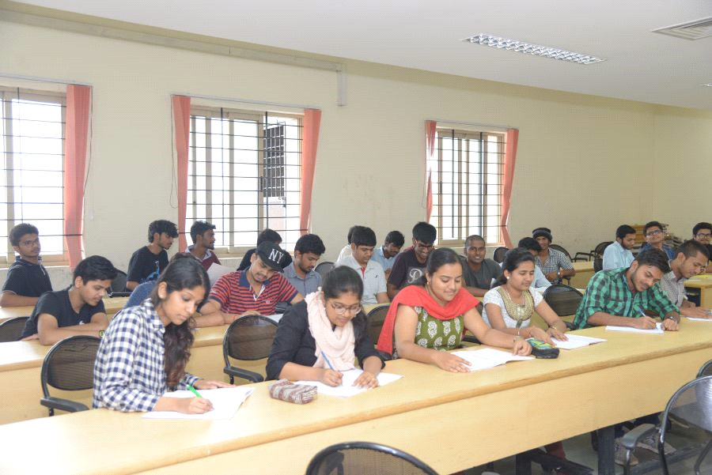
Literature survey
Manual system
Present manual system is file based and increases the writing work load of students.

Slide 6
Manual system
Features
Files are maintained.
Assessment is done manually.
Students write the practicals and assignments.
Submit them in viva.
Upgradation
Files will be maintained online.
Writing work load will be decreased.
Assessments will also be done online.
Backup of student’s work will be maintained.

Slide 7
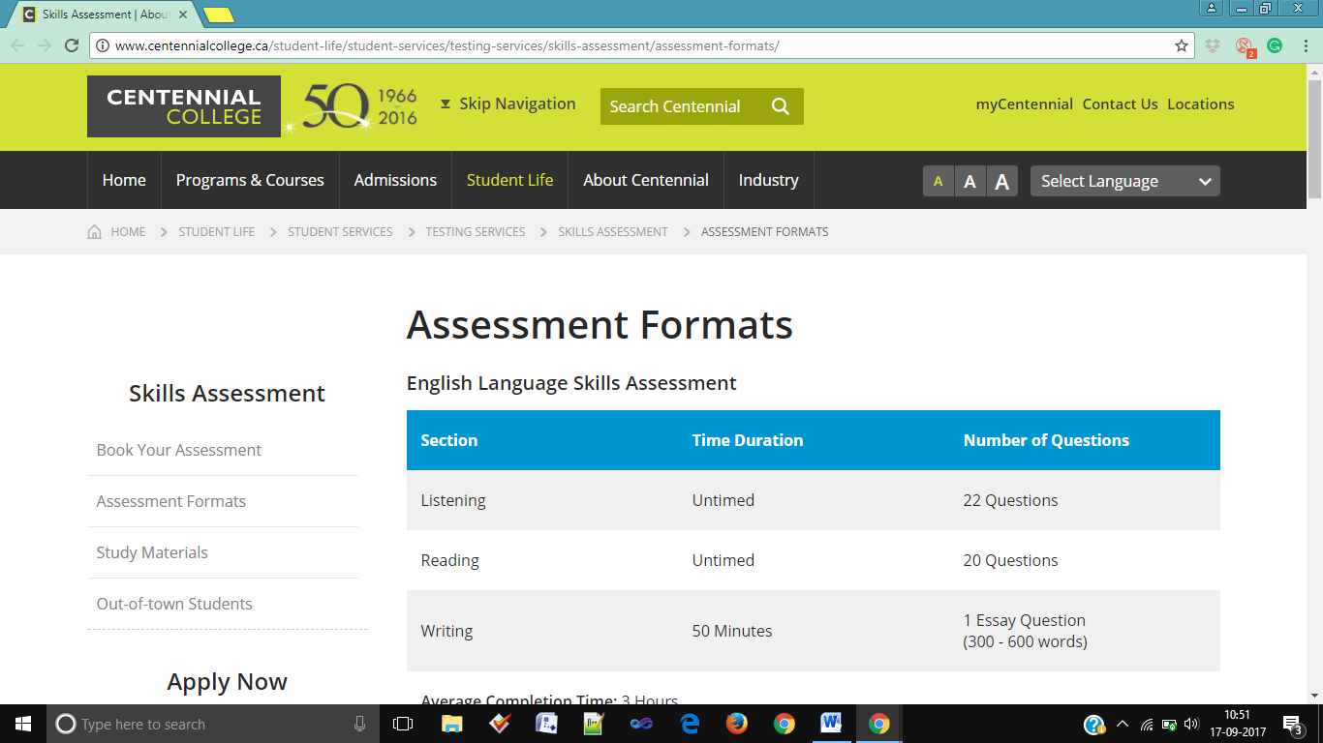
Centennial college

Slide 8
Centennial college
Features
Assessment is done online.
Details are provided.
Study material is provided on website.
Admission process is maintained.
Upgradation
Provides assessment of practicals and assignments of labs and not just question papers.
Circulars will be made available.
It will be particular to a department.

Slide 9
Problem Identification and Definition
Problems with current systems:
The current system in collages, as we know, is totally depended on files.
Student has to perform the entire practical first and then write down them in files to get them assessed with the faculty. This system is time consuming and there is big possibility of student copying one another’s work.
There is no record generated at the end of the semester of every student for faculty’s convenience.
The circulars about important things are not able to reach to every student in the department.

Slide 10
Problem Identification and Definition
Practical and assignments given by faculty earlier are not been recorded and cannot be retrieved.
The big disadvantage of this system is that the files might be lost and the pages can get torn.
There are assessments websites online which gives us the facility to get the papers assessed but they also cannot get the whole department checked and they also require money.

Slide 11
Definition
LOADLESSLABS is the project which resolves all the major issues. It provides facility to save all the work and the grades online. It also gives the facility of passing the circulars online as well it keeps all the records of the student’s grades and all the practical lists.

Slide 12


DETAILED DESCRIPTION OF PROBLEM
Maintenance
The practical are written by the students in file pages in the file system. These files are hard to maintain. There are possibilities of file getting lost or pages getting torn.
Copying the work
In the file system, the students can copy the work of some other student and not perform the work by his/her own.
Even the faculties are not aware of the situation and the student can gets their work checked.

Slide 13

DETAILED DESCRIPTION OF PROBLEM
Circulars
The circulars in collage are passed either on the notice board or by the class representatives. Not all the students check the board every day and representatives might not be able to pass on the messages on time Passing the message also creates confusion as the message might not be passed fully and there might be questions from student about the circulars.

Slide 14
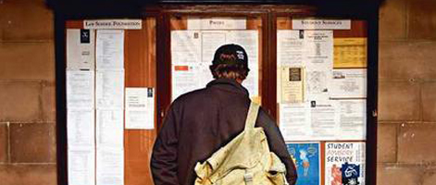
DETAILED DESCRIPTION OF PROBLEM
Records
In the file system, there are no reports generated at the end of the semester. The faculty gives the grades to each practical or assignments on witch’s bases the final grades of the semester are given. Because of no records they have to go through all the file work of the semester.

Slide 15

DETAILED DESCRIPTION OF PROBLEM
Getting the practical lists
The practical lists are not always given
to students in advance by the faculties.
In some cases the students have to go
to the faculties and get some of the
next practical. And the students have to
make their own index manually.

Slide 16
EXPECTED IDP RESULT
4.1 PRUPOSED SYSTEM
We try to propose a system (LOADLESSLABS) which will solve all the major issues in the current manual system. The practical and assignment will be submitted online which will force each student perform them individually. Also records will be maintained and circulars will be provided.

Slide 17
EXPECTED IDP RESULT
4.2 FEATURES
LOADLESSLABS is the project which overcomes most of all the major issues of the file system which is going on in the colleges right now.
Profiles
The user will be asked to create the profile first. There are three roles for the profile: Admin, Faculty and Student. Students will be submitting their work andFaculty will assess the work of the student. Admin will be handling the system. Everyone will be saving their work in their profiles.
Online editors
The projects provides the online text areas in which student can write the answers of their assignments. The student will be able to save and submit their work. The faculty will also be able to know that how many students have submitted.

Slide 18
EXPECTED IDP RESULT
Online assessment
Once the student submits the work, the faculty will be able to assess their individual work online. they are also given the privilege to grade the individual student.
Records
When the faculty will give the grade to the assignment and practical work, it will be saved directly in the student’s grade history. All the student has their own history which is helpful to faculty and student to keep track of their work.
Backup
The system will be keeping the backup of all the work. So in case of data loss, the data will be provided without any lose.

Slide 19
EXPECTED IDP RESULT
Circulars
The faculties and the admin will be able to get the circulars uploaded on the site. The circulars will be shown on the home page of the site. By uploading the circulars on the site, will be convenient for students as all will be able to see them.
Prints
If the print of the work is required(most likely in viva examinations), the faculty will give the permission to the student to get the print copy of the work once after all the assignments / practicals are submitted.

Slide 20
EXPECTED IDP RESULT
4.3 Modules
Login/Registration
The users will be registered by the HOD using their Gmail id and will students will change their id and password while first login. Later on the login will be done using the new id and password and by the id, system will define the roll and the user’s privileges.

Slide 21
EXPECTED IDP RESULT
Admin
The HOD of the department will handle this module as it will possess the supreme privileges. It will be his duty to add faculties and students by registering them with their email id. Deleting particular user will also come under his privileges. Its main function will be to maintain the website and sole issues if any.

Slide 22
EXPECTED IDP RESULT
Faculty
All the faculties will upload the assignments in file formats which will appear with editors to students. After uploading their practicals the faculties will assess them and assign grades. Also the faculty will have its own profile maintained. They will have the privilege to let the student print the entire semester’s work once the entire file has been made.

Slide 23
EXPECTED IDP RESULT
Student
Students will be the end users of the system. They will login using their id and password. All the subjects’ practicals and assignments along with the required editors will be provided to them. They will submit their code or text and it will be accesses by the faculty. Each student will have its profile to view the work.

Slide 24
EXPECTED IDP RESULT
4.4 working flow of the system
The system when entered asks for the login id and password in order to access the system.
For the first login the id will be the Gmail id and there a system generated password sent to the student via mail. Later on the student will need to change the id, password for security and ease.
After login, the system defines the role of the user weather it is an admin, faculty or student and gives privileges accordingly.

Slide 25
EXPECTED IDP RESULT
If the user is a student, it can select from subjects and enter to the assignments and practical modules for each subject separately. He/She can submit solutions till the last submission date and check for grades later on. Also the student can print the entire work once all the practicals are submitted. It can view circulars.
If the user is a faculty, it can see which subjects it takes and enter to the submitted assignments and practicals of each student in his/her lab. It can assess them and give grades. Also can use the record in the viva sessions to know the students work throughout the sem. also the faculty can upload the circulars.
If the user is admin, it can add new users as faculty or students. It can manage all the profiles and can review all the work going on in the system. It has the highest privilege in the system and can delete any profile if required.

Slide 27
EXPECTED IDP RESULT
4.5DEVELOPMENT TOOLS AND TECHNOLOGIES
Front-end and Back-end:
Front-end and back-end are terms used to characterize program interfaces and services relative to the initial user of these interfaces and services. A "front-end" application is one that application users interact with directly. A "back-end" application or program serves indirectly in support of the front-end services.
The Front-end for this application: java Netbeans, Java Server Pages.
The Back-end for this application: Oracle database.
Using java programming language as front-end provides greater security and has good database connectivity.
In Oracle, Backup and recovery procedures protect your database against data loss and reconstruct the data.

Slide 28
PROJECT DESIGN
6.1 USECASE DIAGRAMS

Slide 29
Admin

Slide 30
Faculty

Slide 31
Student:

Slide 32
6.2 ENTITY RELATIONSHIP DIAGRAM

Slide 34
6.3 DATA FLOW DIAGRAM
Level 0 DFD of the system:

Slide 35
Level 1 DFD of the system:

Slide 36
Level 2 DFD of the system: Log in:

Slide 37
Registration:

Slide 38
Upload question files, Submit answer files:

Slide 39
Assessment:

Slide 40
6.4 DATA DICTIONARY
1.ROLE:
2.LOGIN:
Field | Datatype | Size | Key/Constraint
ROLE_ID | Number |  | Primary key
ROLEN_AME | Varchar2 | 10
Field | Datatype | Size | Key/Constraint
U_NAME | Varchar2 | 30 | Primary Key
PASSWORD | Varchar2 | 10 | Not Null
ROLE_ID | Number | 1 | Foreign Key

Slide 41
3. REGISTRATION:
Field | Datatype | Size | Key/Constraint
REG_ID | Number | 3 | -
FIRSTNAME | Varchar2 | 15 | Not Null
LASTNAME | Varchar2 | 15 | Not Null
U_NAME | Varchar2 | 30 | Primary Key
EMAIL_ID | Varchar2 | 30 | Not Null
CONTACT_NO | Number | 10 | Not Null
SOC | Varchar2 | 20 | -
LANDMARK | Varchar2 | 30 | -
AREA | Varchar2 | 15 | -
CITY | Varchar2 | 20 | Not Null

Slide 42
4. QUESTION_DETAILS:
Field | Datatype | Size | Key/Constraint
ID | Number | - | Primary key
SUBJECT_ID | Number | - | Not null
REG_ID | Number | - | Foreign key
FILE_NAME | Varchar2 | 50 | Not null
ASSIGNMENT_NO | Number | - | Not null
PRACTICAL_NO | Number | - | Not null
IS_PRACTICAL | Boolean | -

Slide 43
5. ANSWER_DETAILS
Field | Datatype | Size | Key/Constraint
ID | Number |  | Primary key
REG_ID | Number |  | Primary key
GRADE | Varchar2 | 2 | -
FILE_NAME | Varchar2 | 50 | -
IS_CHECKED | Boolean |  | -
WRONG | Boolean |  | -
IS_SAVED | Boolean |  | -

Slide 44
6. SUBJECT_DETAILS: 7. CIRCULAR:
Fields | Datatype | Size | Key/Constraint
SUB_ID | Number | - | composite primary key
SUBJECT | Varchar2 | 10 | Not Null
SEM | Number | - | Not Null
REG_ID | Number | - | composite primary key
SUGGESTED_BOOK | Varchar2 | 75 | -
IS_PRACTICAL | Boolean | - | Not Null
Fields | Datatype | Size | Key/ constraint
C_NO | Number | 5 | -
C_NAME | Varchar2 | 20 | -
REG_ID | Number | - | Foreign key
SUB_ID | Number | - | Foreign Key

Slide 45
THE OUTLINE OF WORK TO BE CARRIED OUT IN SEM- VI DURING PART-II
THE CORE PART:
The core part of any web application is it’s coding and internal construction which defines hoe the software will work under particular events and requests. Without this the software would nearly be an eye candy and would not fulfill its requirements.

Slide 46
THE WAREHOUSE:
Even if the software has the perfect working and an attractive front end, unless it knows how to manipulate data, it would merely be a one-time run and cannot survive as an independent software. The software warehouse that is a database is a must have.
THE PRESENTATION:
The front end or the user interface presents to the end user the entire software in an easy to understand, working and useful manner.

Slide 47
CONCLUSION
The idea of this project, LOADLESSLABS, was basically an invention that came from a need of reducing the workload and optimizing the entire file process to a situation where students can focus on practicals which would be great for their future and enhance their skills.
This web application will solve all the major problems for the students as well as faculties.

Slide 48
The website will work as an e-assessment portal of practicals and assignments, as well as, provide required information and circulars to all, will reduce communication inconvenience and maintenance of records.
In short it increases the ease for both students and faculty.

Slide 49
REFERENCES:
The complete reference in JAVA edition 9.
Coding in JAVA.
The beginner’s guide volume 1.
Core JAVA Fundamentals.
BIBLIOGRAPHY:
www.javatpoint.com
www.hackerrank.com
www.codechef.com
www.stackoverflow.com

Slide 50
Project Implementation

Slide 51
Common functionalities:

Slide 52
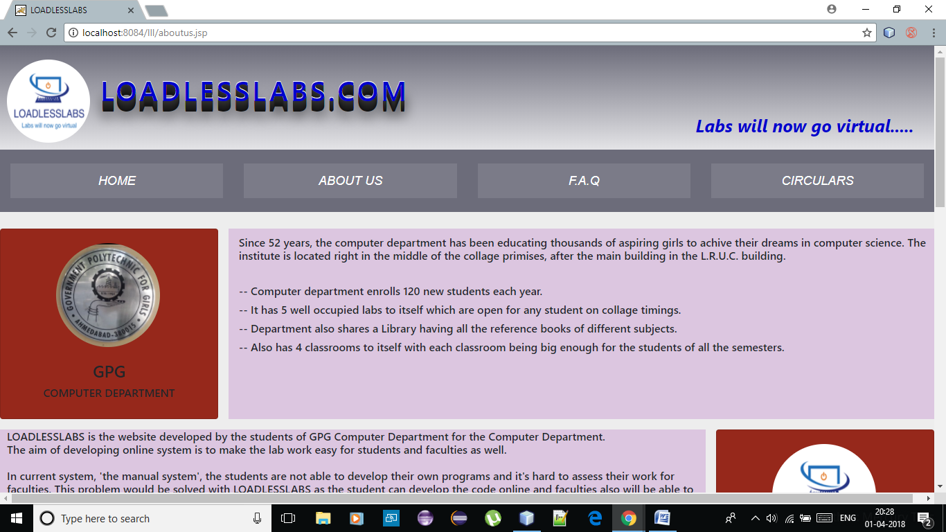
About us: this page includes the overview of the system and the college.

Slide 53
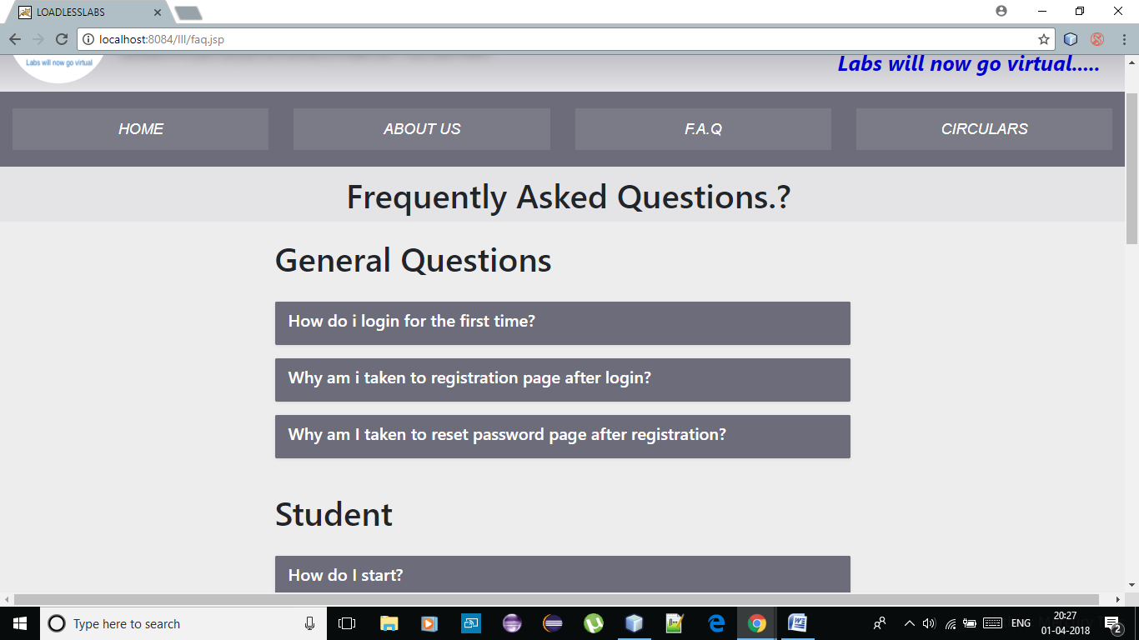
F.A.Q. Page: This will have the basic questions about the system and answers to them.

Slide 54
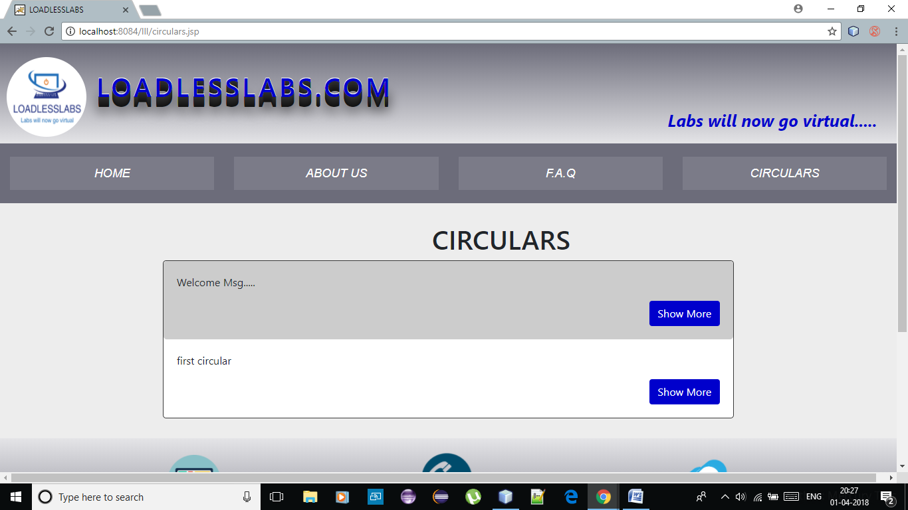
Circulars: this page will list the circulars.

Slide 55
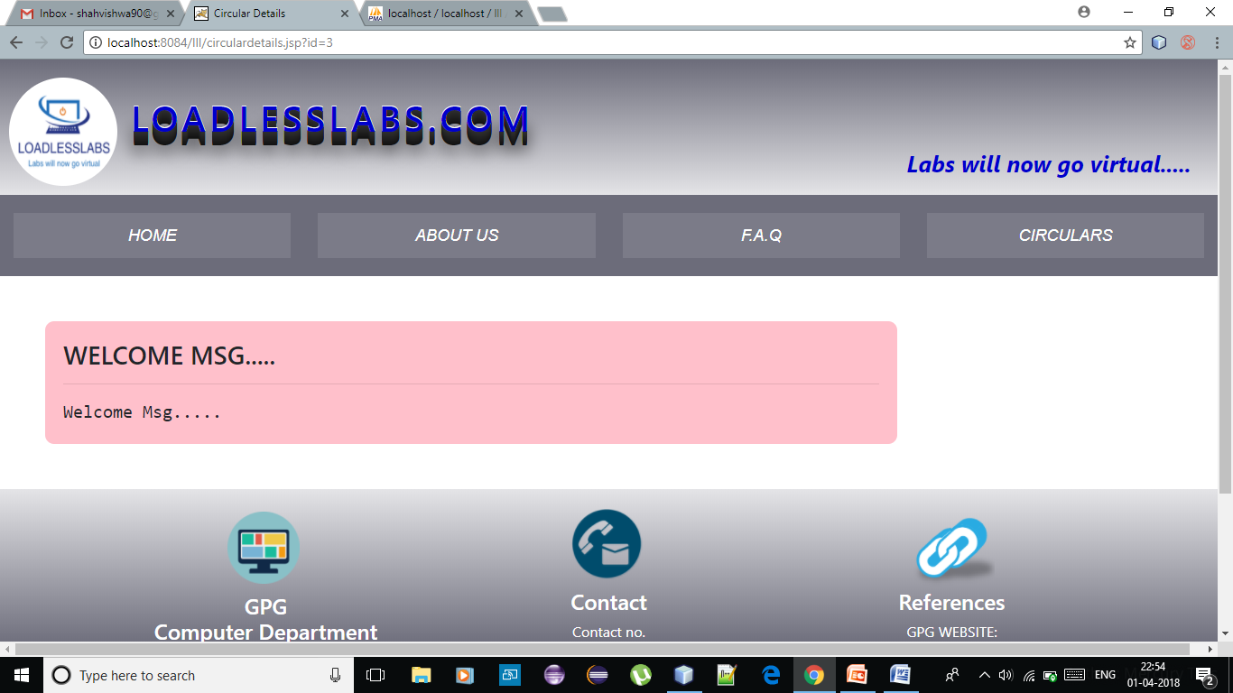
Clicking on ‘Show more’ will lead to the extension of the circular and showing the whole circular.

Slide 56
Functionalities based on users:

Slide 57
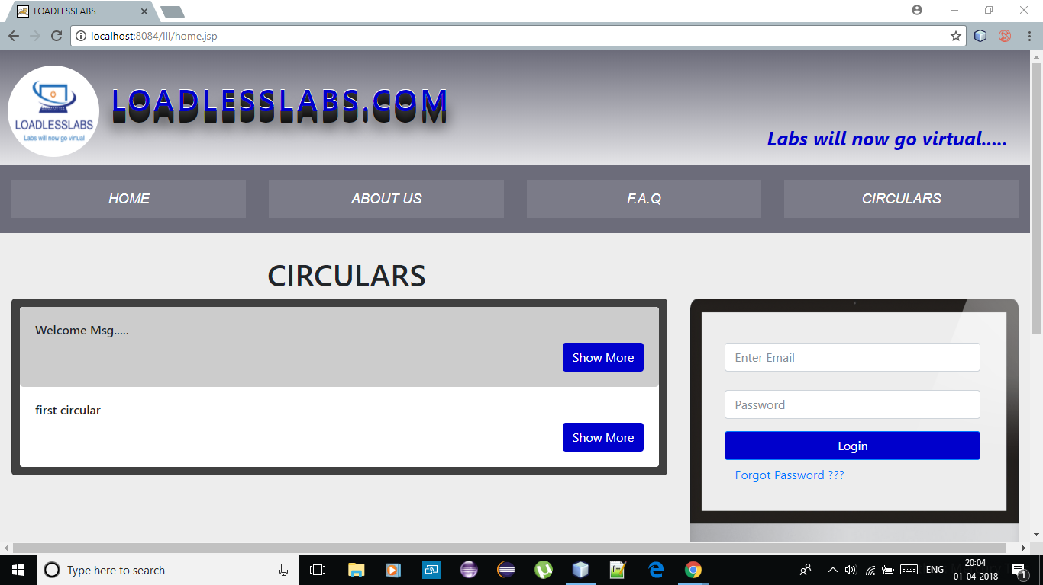
Home page:

Slide 58
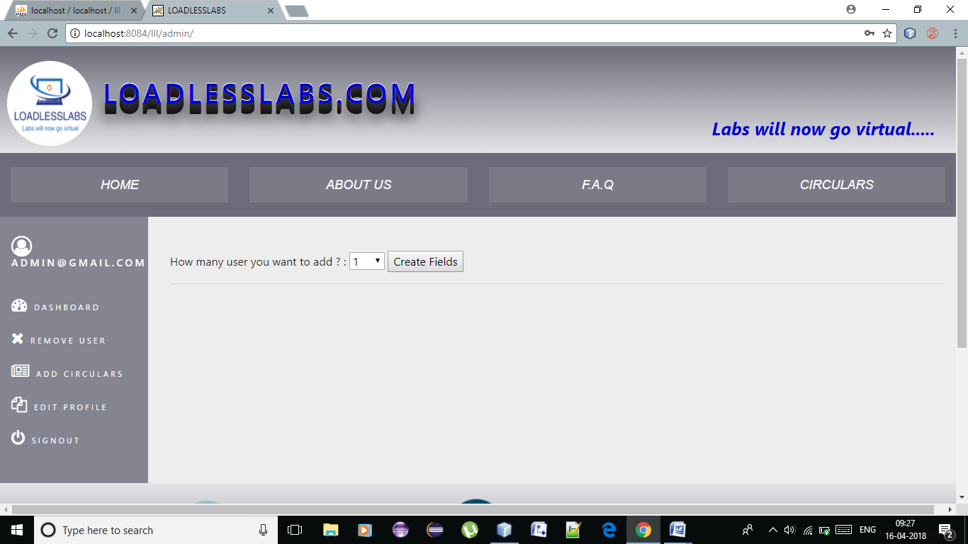
Dashboard of admin: from here, the can add users, both faculties and student…

Slide 59
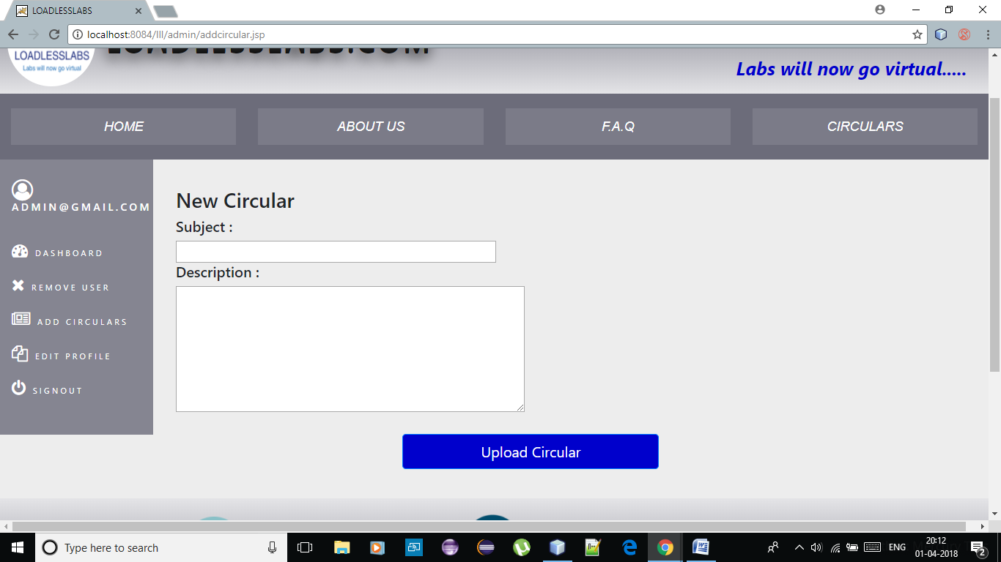
Locking Users: From here, admin can lock and unlock the users which gives users the priviledge to use the system.

Slide 60
Uploading circulars: From here, admin can upload the circulars which will be displayed on the home page.

Slide 61
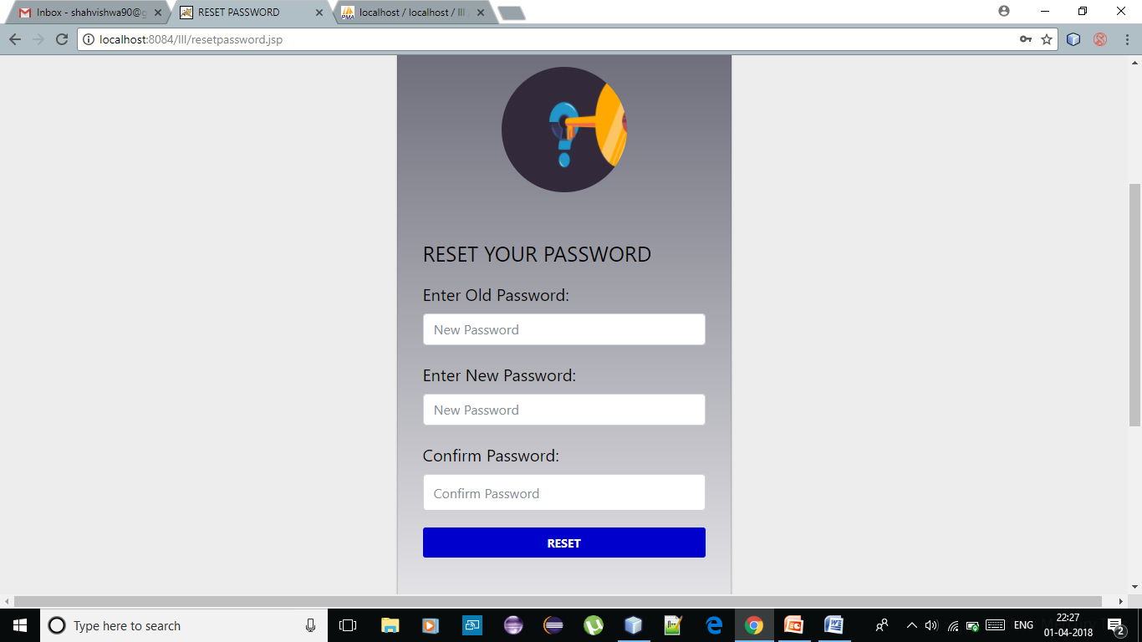
Mail sent to each user: a mail will be sent including a computer generated password with which the user will first login. After logging in for the first time the user will be asked to update the password

Slide 62
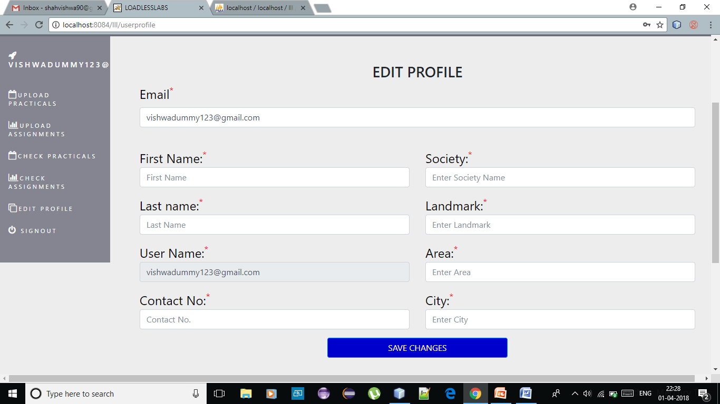
Edit profile: from there they will be directed to edit profile page to save their information.

Slide 63
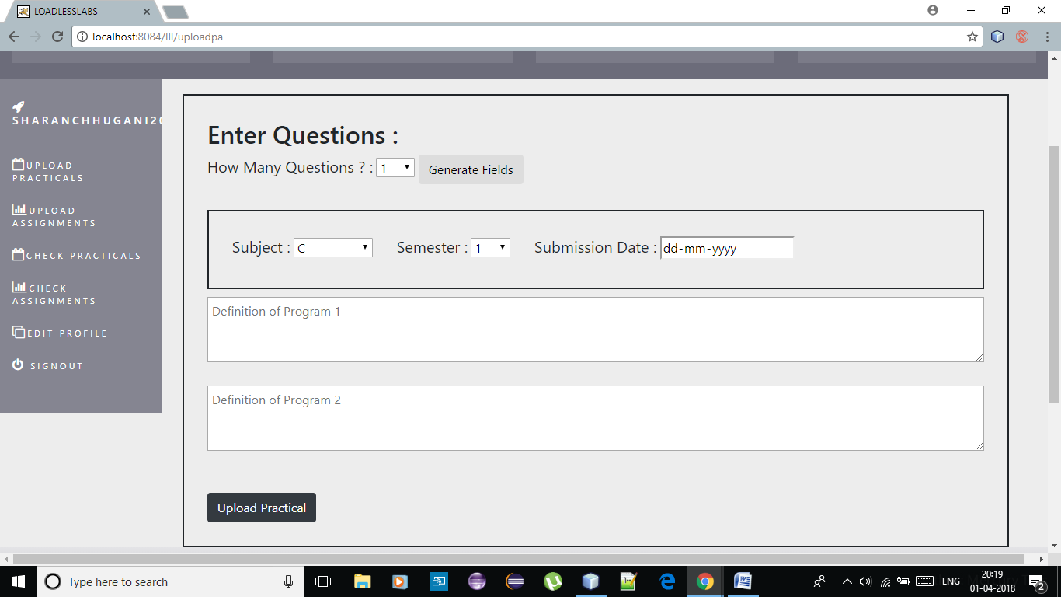
Upload practical: Faculty can upload the practical from here…

Slide 64
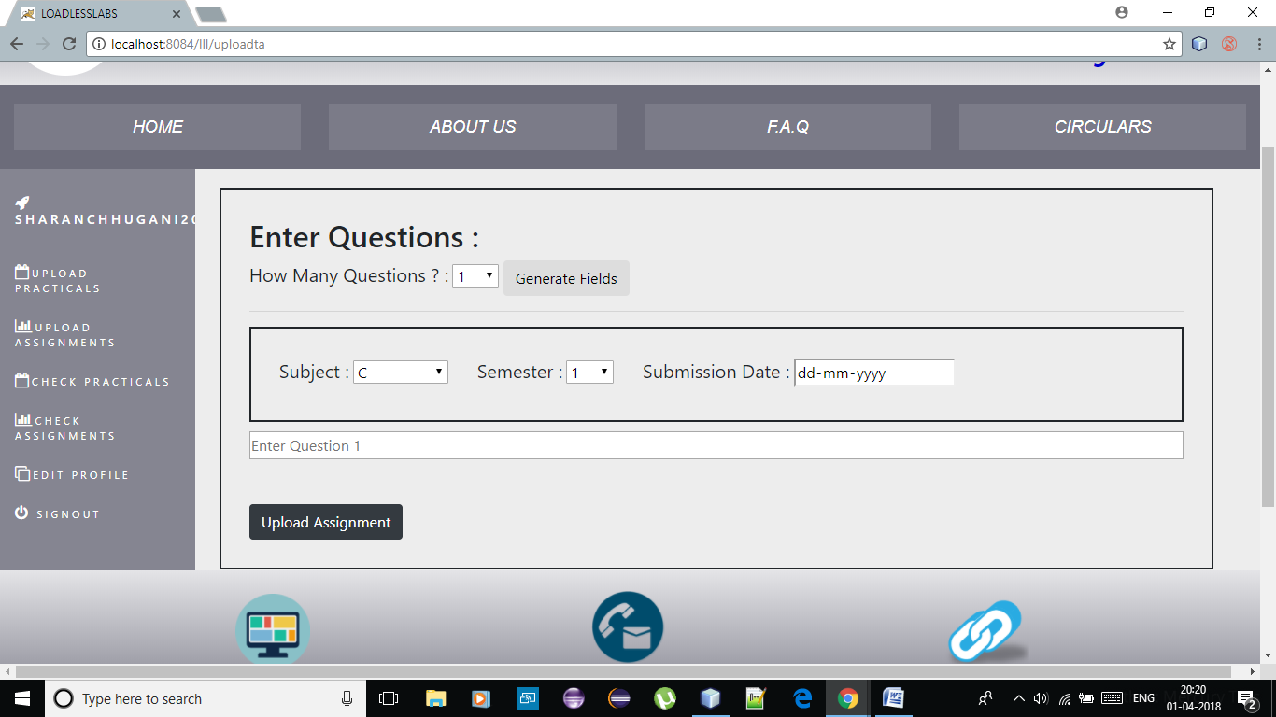
Upload assignments: From here faculty can upload assignment

Slide 65
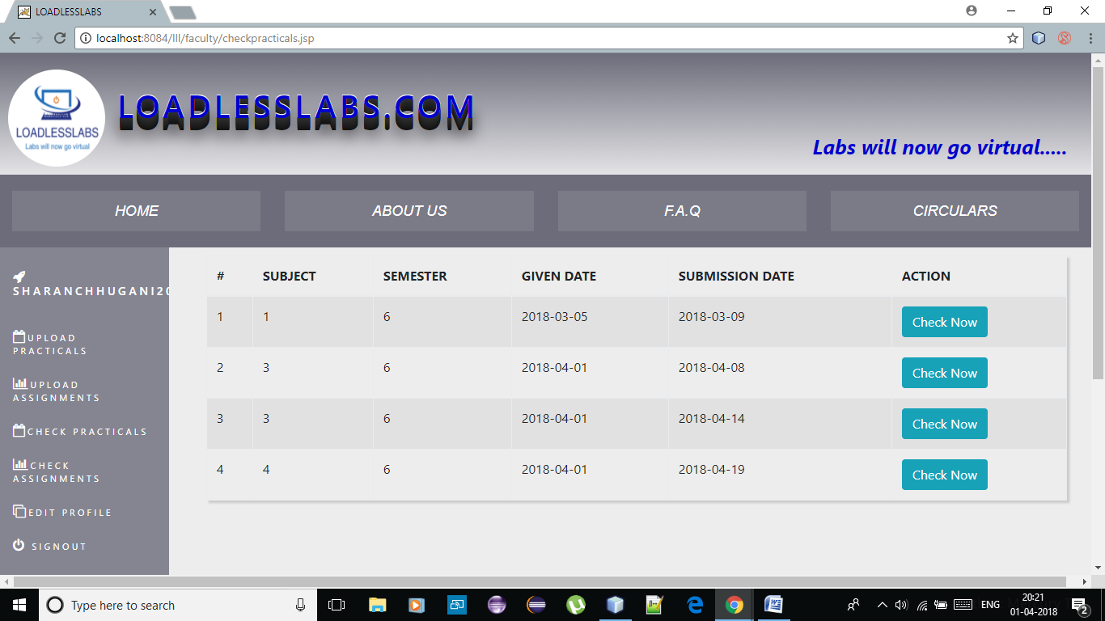
Check practical: The practical submitted by the students will be listed here.

Slide 66
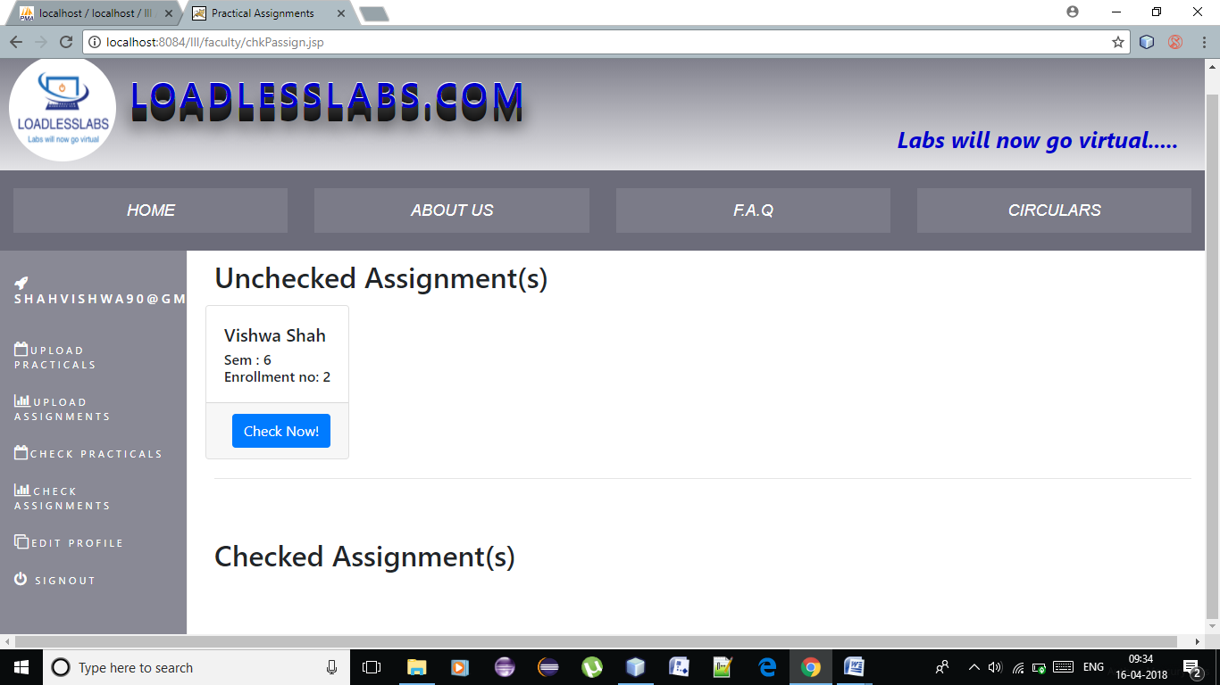

Slide 67
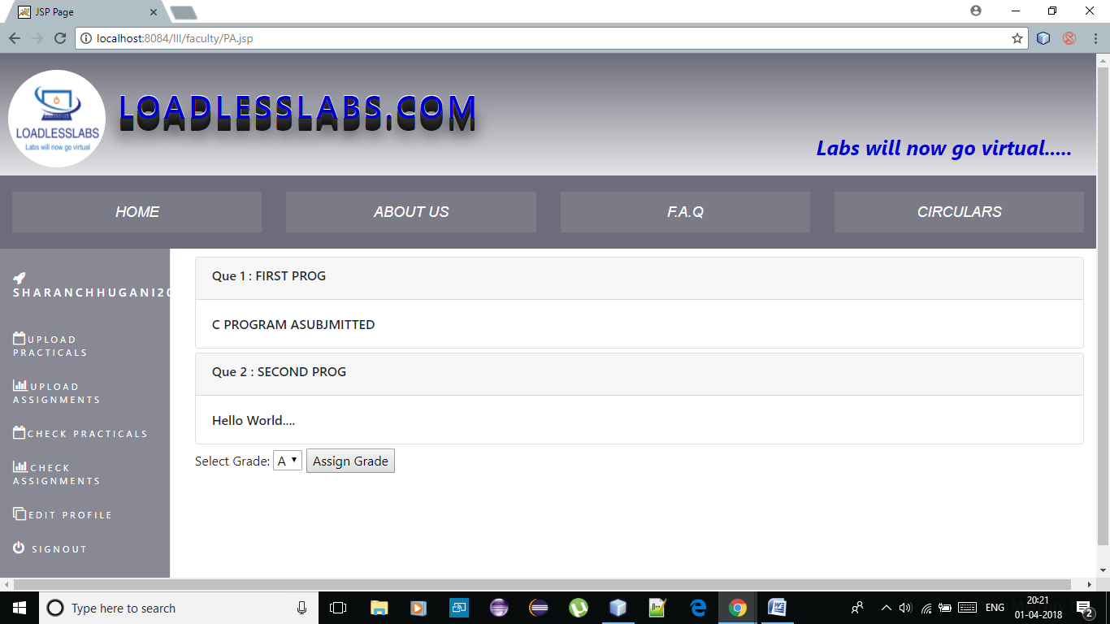

Slide 68
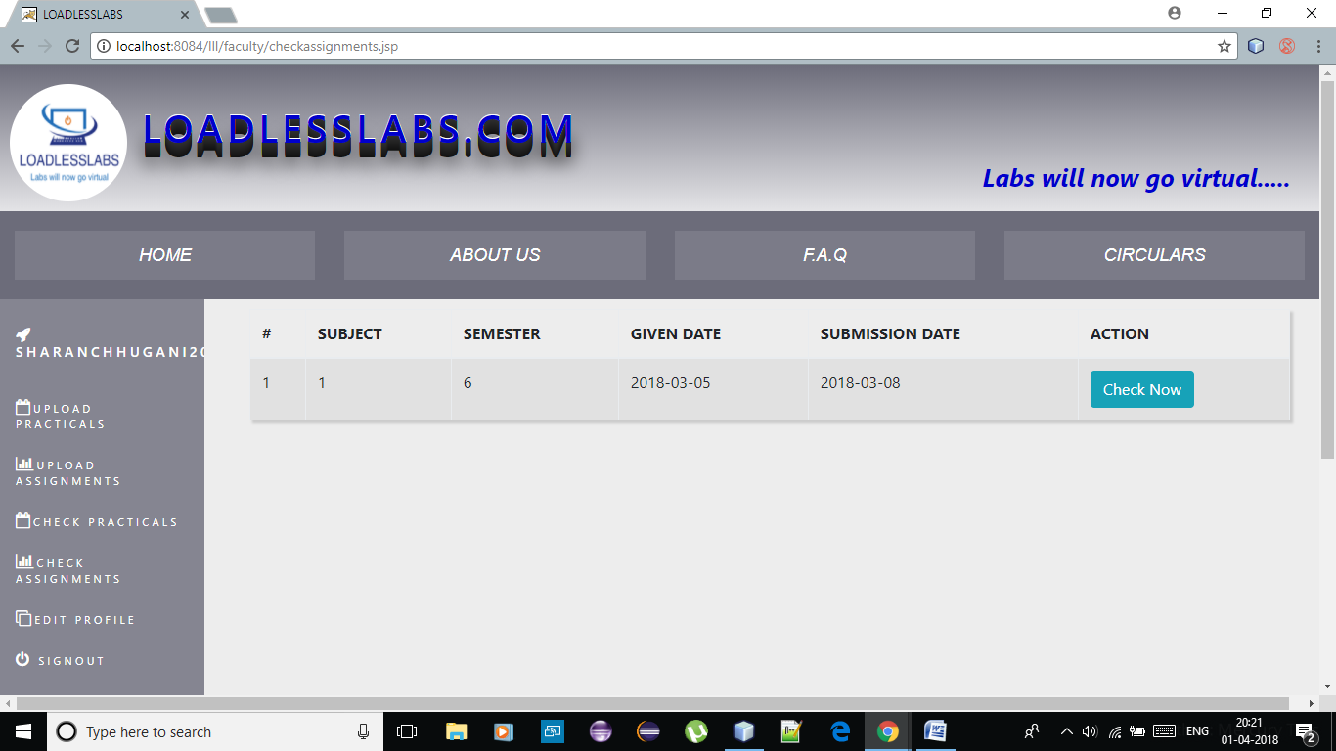
Check assignments: all the assignments submitted by the students will be listed here…

Slide 69
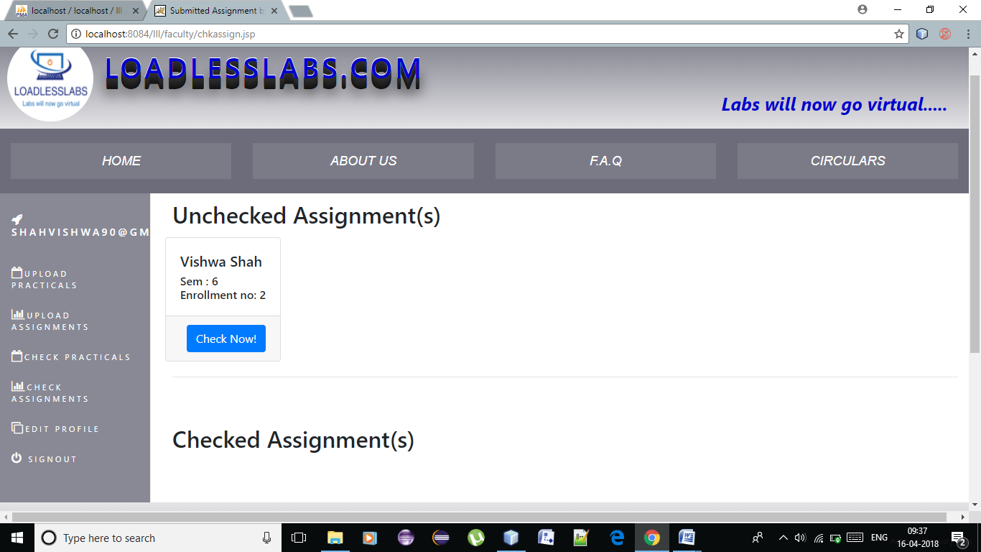

Slide 70
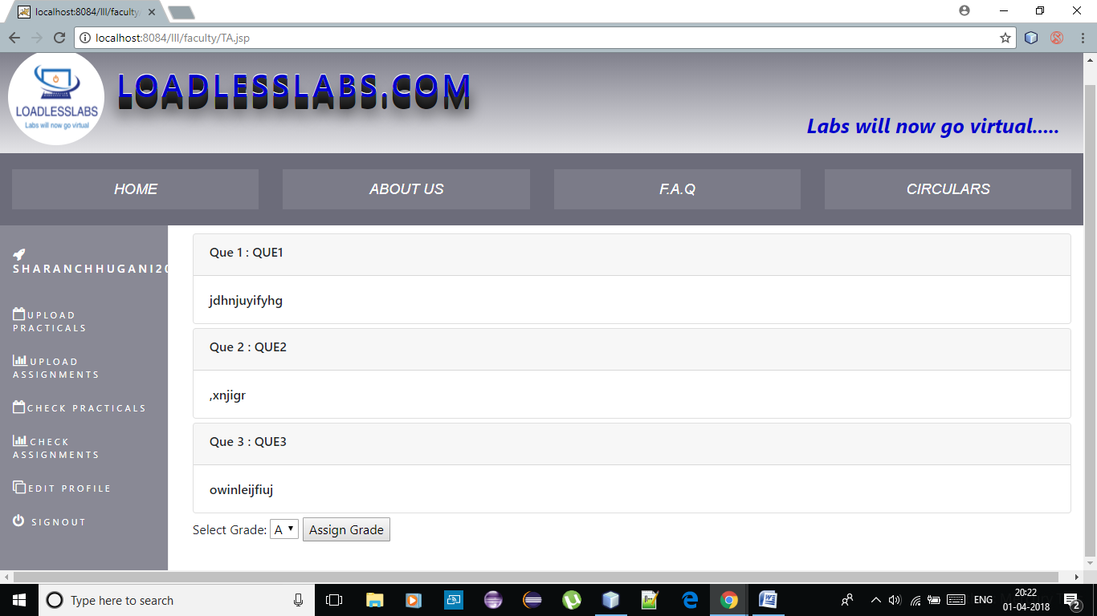

Slide 71
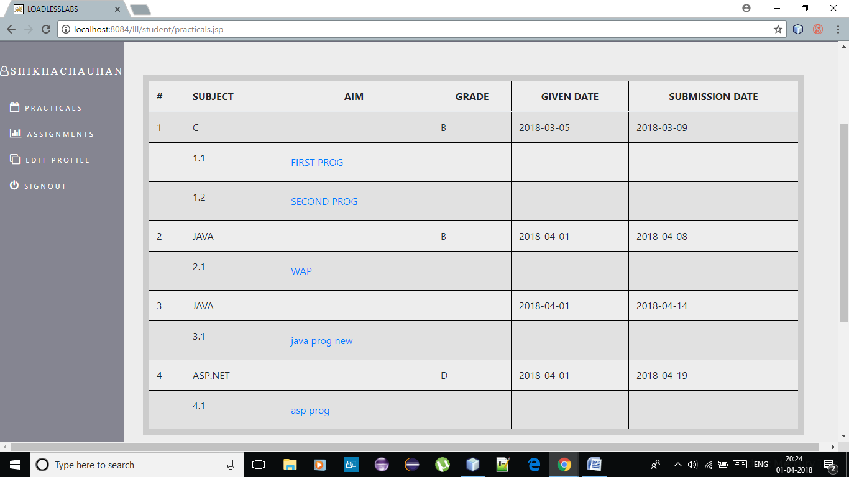
Practical list: student also will be asked to change their passwords and edit profiles…in this section, students will be shown the list of practical of their semester.

Slide 72
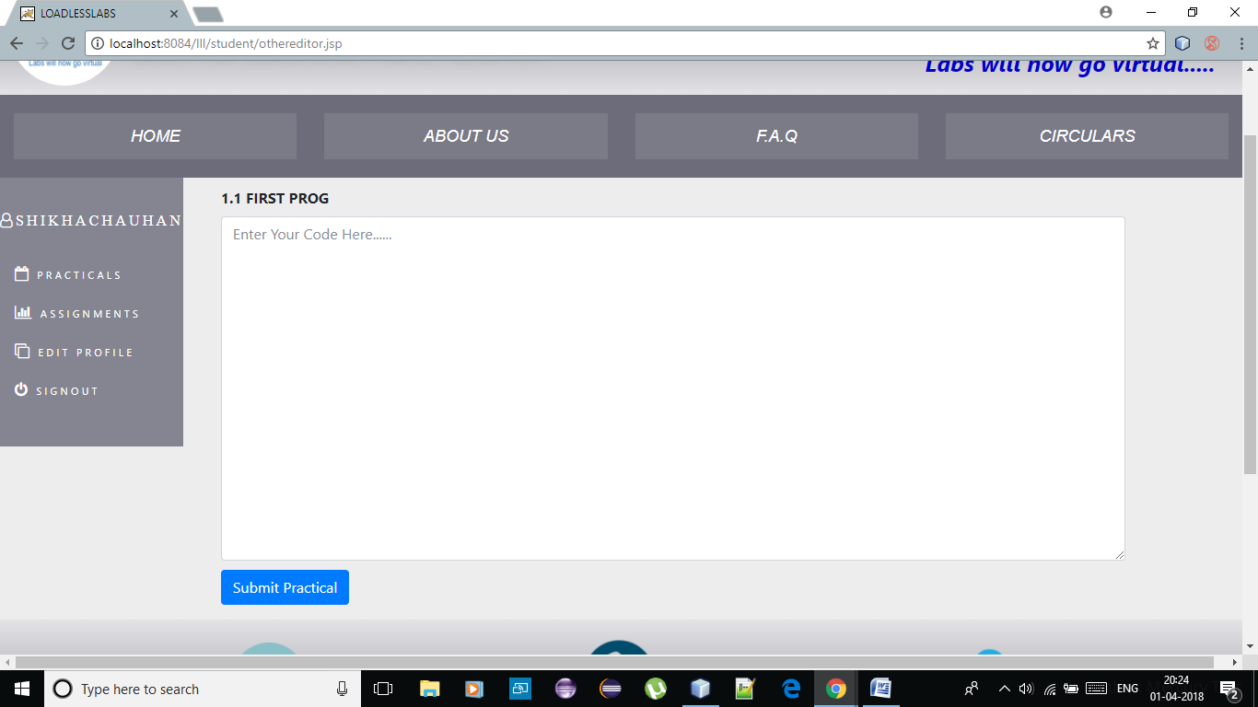
Editors:

Slide 74
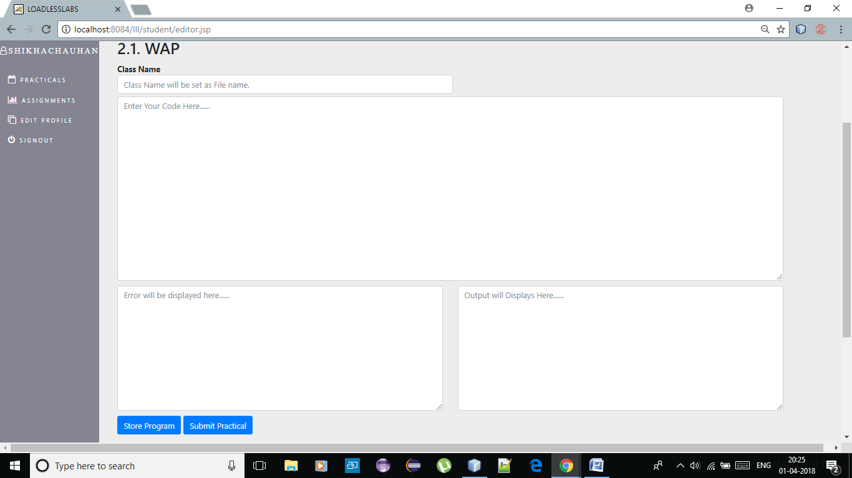
For java practicals:

Slide 75
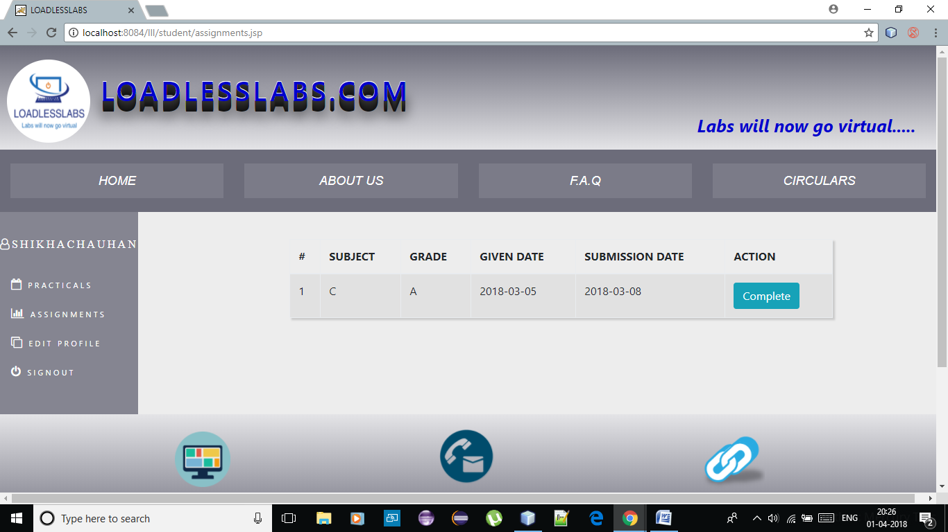
Assignment list: the assignment uploaded by the faculty will be listed here.

Slide 76
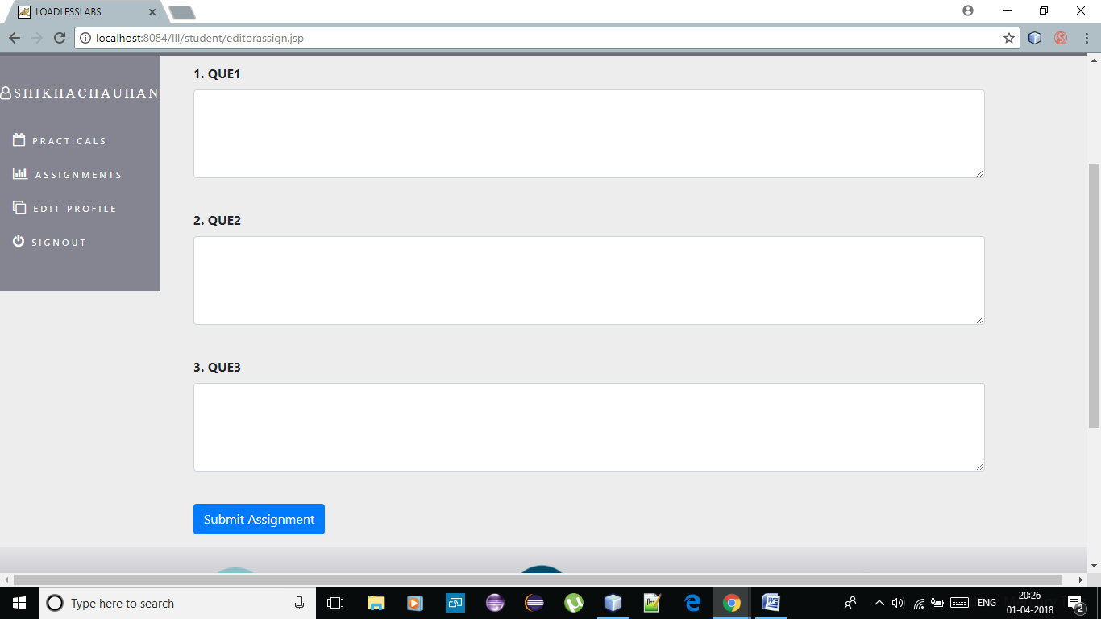
Editor for assignments:

Slide 77
Presented BY: SHIKHA CHAUHAN SHARAN CHHUGANI VISHWA SHAH

